Slide 1
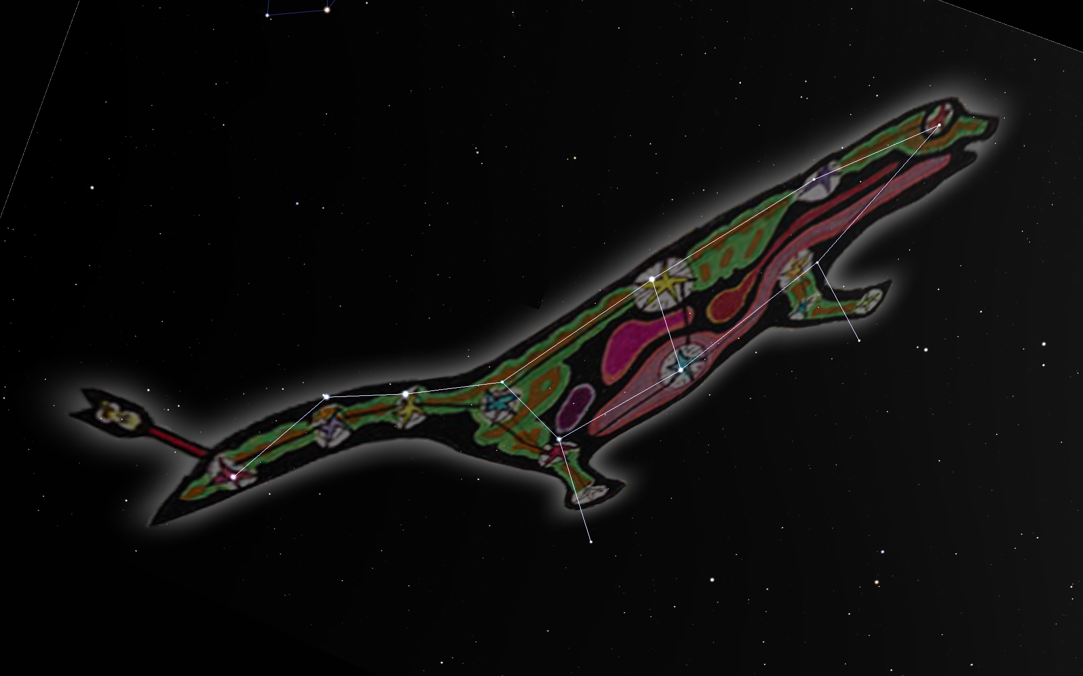
The constellation of Fisher

Slide 2
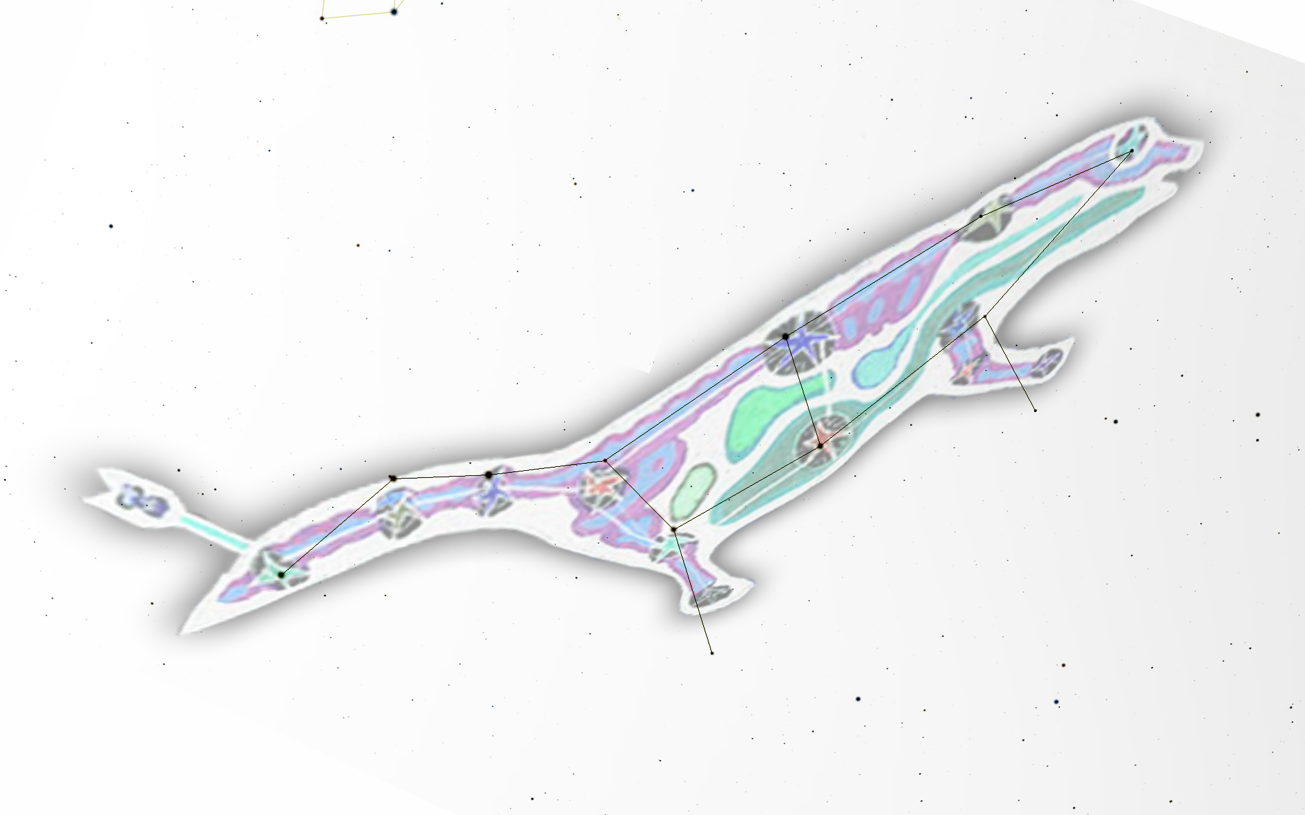

Slide 3
Muscida
The stars of Fisher
23 UMa
Dubhe
29 UMa
Mizar
Megrez
30 UMa
Merak
Alioth
Phad
Alkaid
Alkaphrah

Slide 4
Star | Actual distance from Earth | String length (cm)
1) Alkaid | 104 light years | 16
2) Mizar | 78 light years | 21
3) Alioth | 83 light years | 20
4) Megrez | 81 light years | 21
5) Phad | 83 light years | 20
6) Alkaphrah | 184 light years | 0
7) Merak | 80 light years | 21
8) Dubhe | 124 light years | 12
9) Muscida | 179 light years | 1
10) 23 UMa | 78 light years | 21
11) 29 UMa | 116 light years | 14

