Slide 1
Notes:
This presentation can be used with the science introduction to the evolution activity. Each slide has notes to explain it.

Slide 2
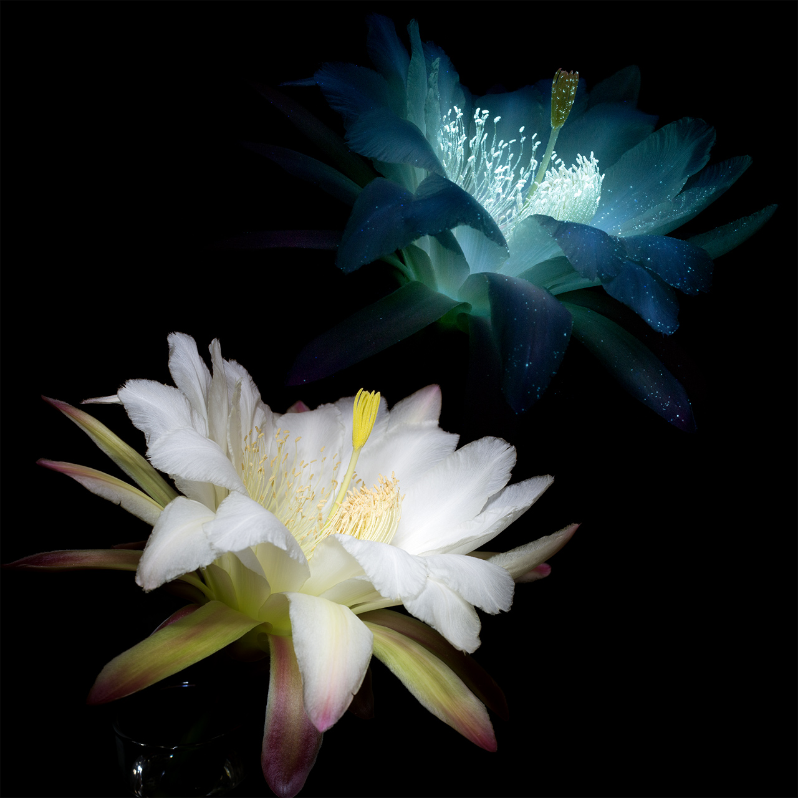
Notes:
If you use the story “King Solomon and the Bee”, you can show this slide at the end to illustrate how different flowers look using other parts of the spectrum. The lower photograph shows a lily in ordinary visible light, the same sort of light we see with our eyes. The upper photograph shows how the same lily looks when ultra violet light is shone on it. The UV light induces fluorescence, the same process that makes white t-shirts glow under UV light in a disco. This is NOT what a bee or a butterfly would see, but it shows how different flowers can look in different parts of the spectrum. Photograph courtesy Craig P Burrows (http://www.cpburrows.com/), used with permission.

Slide 3
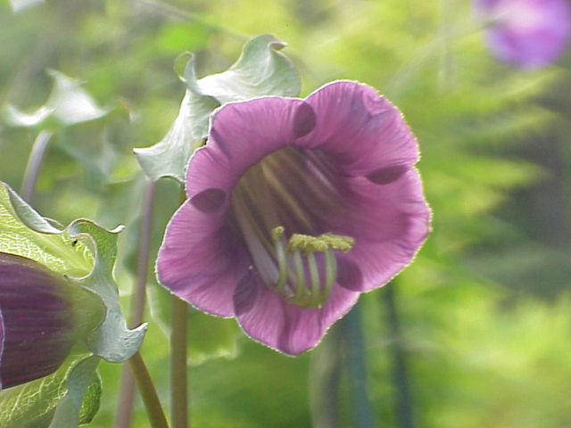
Notes:
This is the cup and saucer plant. This flower has evolved to have a shape that acts as an excellent echo chamber for the sound waves that bats use for echolocation. When a bat sends out it’s sound wavs, they bounce off objects and reflect back to the bat, helping the bat know where obstacles and insects are. The echo chamber of this flower makes it very easy for the bats to find them using echolocation, helping the bat to find food, and the flower gets pollinated in the process.

Slide 4
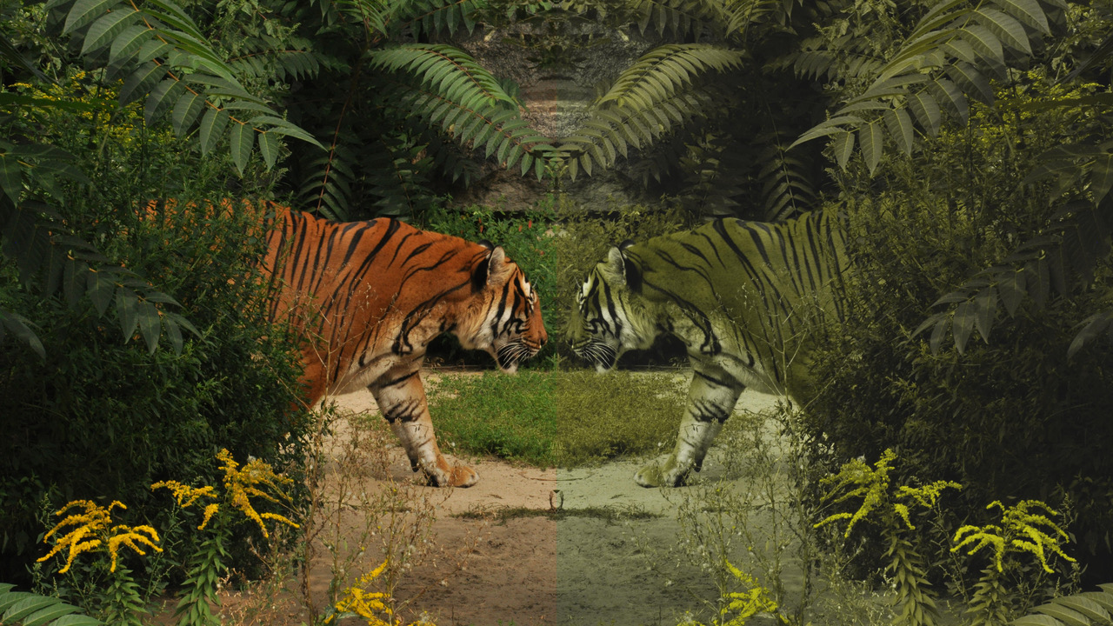
Notes:
Tigers are orange in colour, to human eyes. To us, they stand out against the green background of their habitats such as the rainforest. To us, orang seems a strange colour. Blending in with the background is going to help you remain invisible so that you can sneak up on your prey without being seen. So why are tigers orange? The prey that tigers hunt are actually red-green colourblind so to them, the tiger does blend in with the green plants. Many thousands of years ago, the most successful tigers were those that could blend in and sneak up on their prey, so these tigers were more likely to survive and breed.

Slide 5
Notes:
We are going to imagine we are creating a new colony somewhere in the solar system. We need to take our plants and animals with us, and they might need to evolve to survive in their new environment. Where should we go? The Moon is a good place, because it is very close to the Earth, and is easy to reach. Is the Moon a good place for a colony? Probably not - the Moon has no atmosphere so we would have to take all of the air we need with us, and we would have to live indoors. There is also very little water, so it is not a very good habitat for a colony.

Slide 6
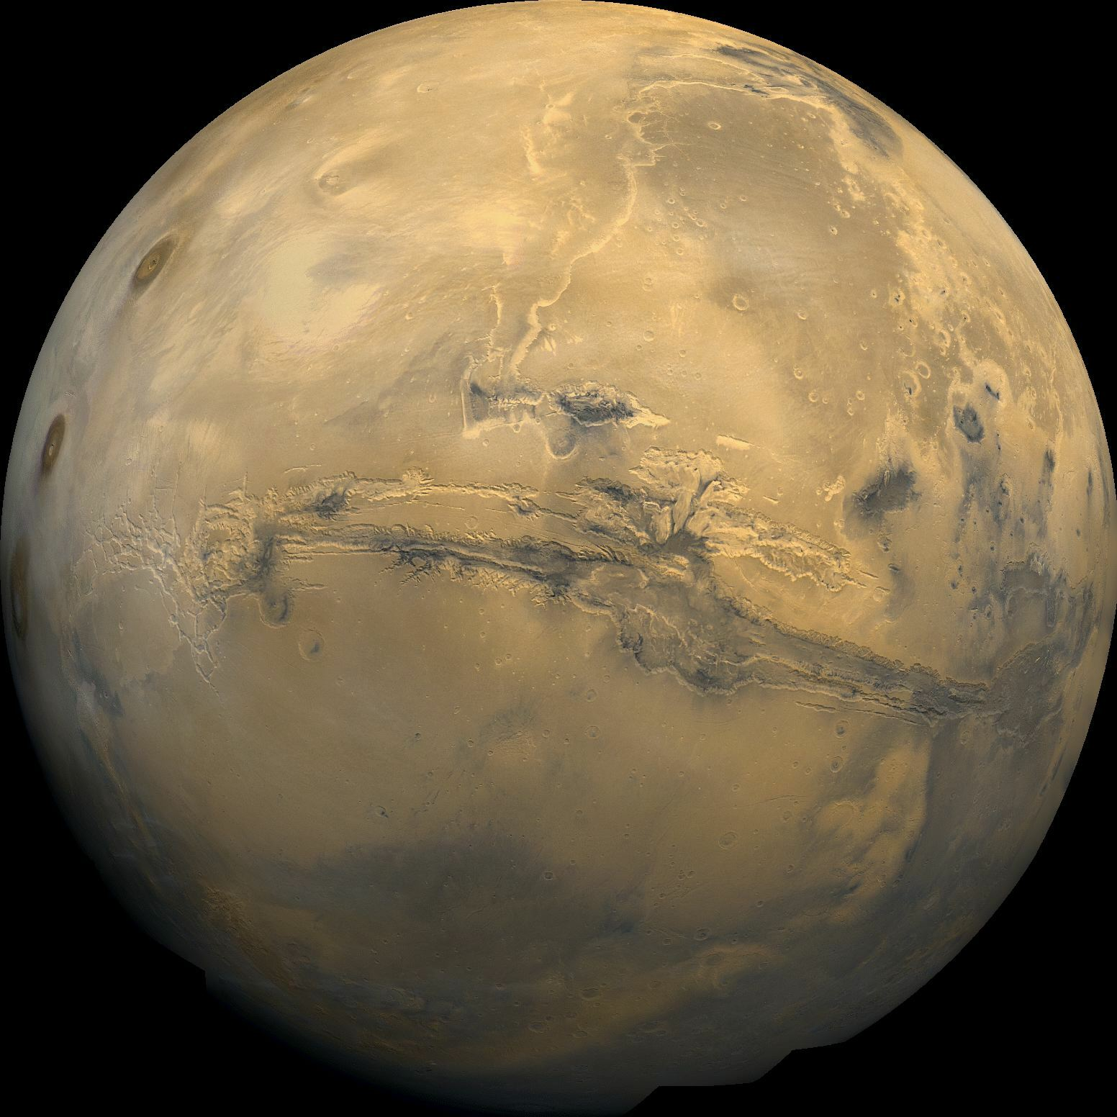
Notes:
Mars is a good place for a colony. It is smaller than the Earth, but larger than the Moon. The Moon is too small to hold on to an atmosphere, but Mars is large enough so we have air here. The air is thinner though, and there is not much oxygen, so animals might need bigger lungs to breathe. Flying animals might also need much larger wings to fly in a thinner atmosphere. There is water here, but it is mostly frozen in a polar ice cap, so animals that swim might need to evolve legs. It is much colder on Mars than on the Earth, so animals might ned to evolve thicker fur, hair or wool. The surface is orange, and there are no plants, so animals might also need to change colour to blend in with their new environment.

