Slide 1
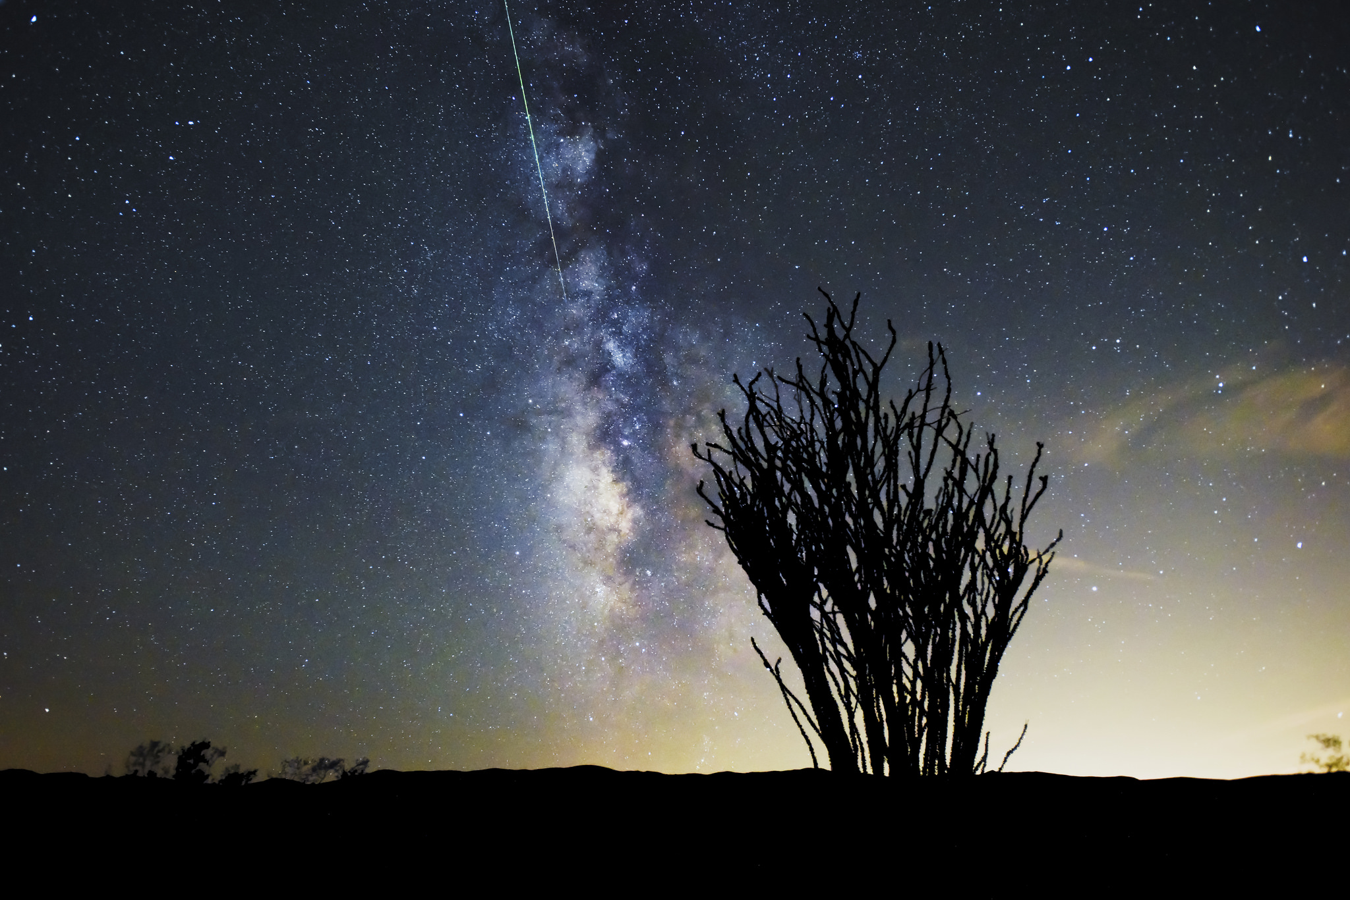
Notes:
This is a shooting star, NOT a comet. While they might appear similar in photographs, they are very different in nature. Meteors will move very fast across the sky and disappear in a matter of seconds, while comets move very slowly across the sky and can be visible over many weeks or months.

Slide 2
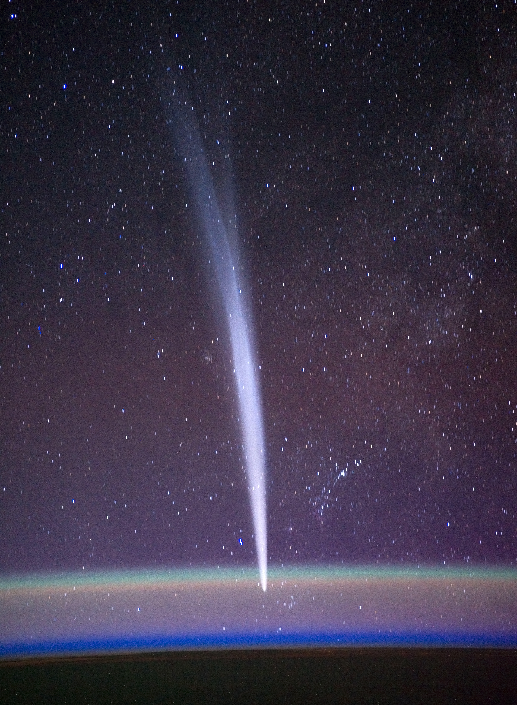
Notes:
This is a comet as seen from the International Space Station, some 200km above the surface of the Earth. The head of the comet (the solid part that resembles a giant dirty snowball, usually only a few kilometres in diameter) is near the bottom of the picture. The tails are much larger and can stretch over many hundreds to thousands of kilometres. This comet appears to be moving into our atmosphere, but in reality it is very far away and we are seeing it through the atmosphere.
By NASA/Dan Burbank - http://spaceflight.nasa.gov/gallery/images/station/crew-30/html/iss030e015472.html, Public Domain, https://commons.wikimedia.org/w/index.php?curid=18881997

Slide 3
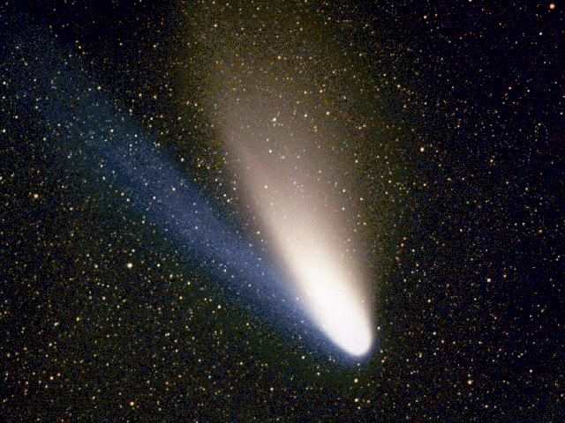
Notes:
This is a photograph of comet Hale Bopp. It very clearly shows the two main types of tail that comets have: the dust tail, and the ion tail. The ion tail is made up of things like water that has sublimated (turned directly from ice to gas without passing through a liquid phase) due to the heat of the Sun. The dust tail is made of fragments of dust and rock that are released as the ice melts. Since dust is heavier than water vapour, the water vapour tail points directly away from the Sun while the dust tail bends slightly. This image clearly shows both tails and the difference in colour between the ion (blue) and dust (orange) tails.
By Geoff Chester - http://www.usno.navy.mil/pao/HBPIX.html, Public Domain, https://commons.wikimedia.org/w/index.php?curid=80725

Slide 4
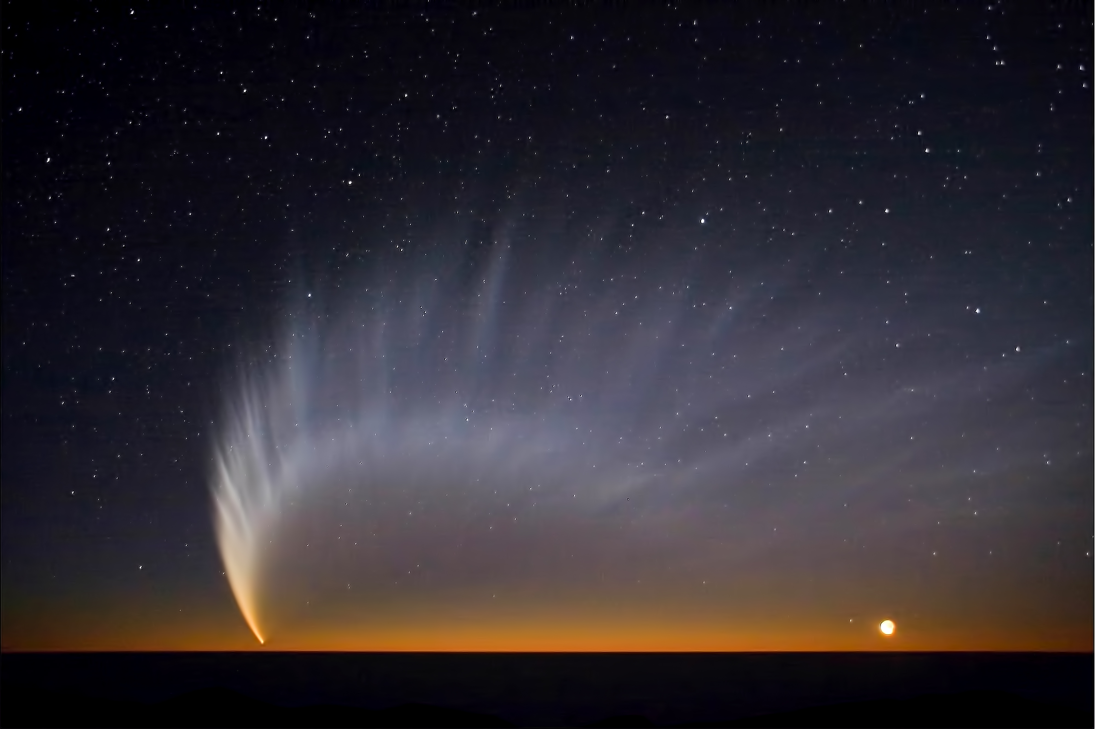
Notes:
This last image shows the famous comet McNaught, as seen from ESO’s observatory at Paranal in Chile. This comet was visible in 2007 and was the brightest comet for 40 years. Unlike most comets, comet McNaught was so bright that it was visible during daytime! The comet was visible to anyone looking at the sky, anywhere in the world in early 2007.
By ESO/Sebastian Deiries - http://www.eso.org/public/images/mc_naught34/, CC BY 4.0, https://commons.wikimedia.org/w/index.php?curid=4791898

